Slide 1
Mechatronics – 302050
Lecture Notes / PPT
UNIT I

Slide 2
Syllabus
Introduction to Mechatronics, Sensors & Actuators
Introduction to Mechatronics and its Applications; Measurement Characteristics: Static and Dynamic; Sensors: Position sensors- Potentiometer, LVDT, incremental Encoder; Proximity sensors-Optical, Inductive, Capacitive; Temperature sensor-RTD, Thermocouples; Force / Pressure Sensors-Strain gauges; Flow sensors-Electromagnetic; Actuators: Stepper motor, Servo motor, Solenoids; Selection of Sensor & Actuator.

Slide 3
What is Mechatronics
Mechatronics is the synergistic combination of mechanical engineering (“mecha” for mechanisms), electronic engineering (“tronics” for electronics), and software engineering.
The word “mechatronics” was first coined by Mr. Tetsuro Moria, a senior engineer of a Japanese company, Yaskawa, in 1969.

Slide 4
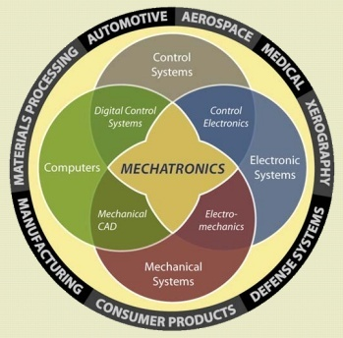
Mechatronics System

Slide 5
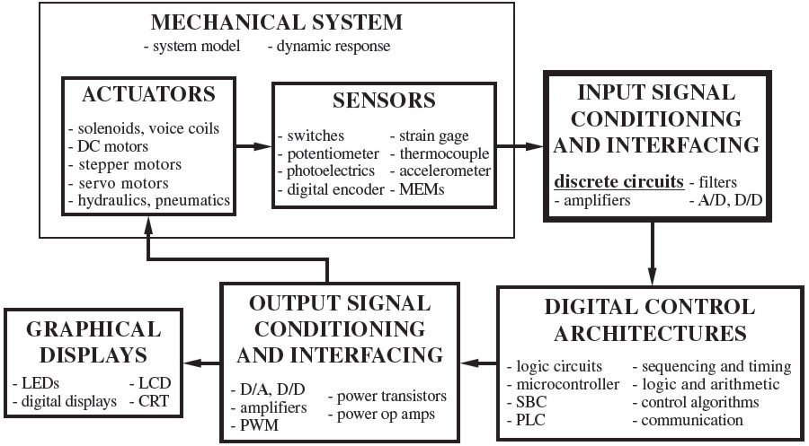
Elements of Mechatronics

Slide 6
Why Mechatronics ?
Advantages & limitations of mechanical systems
Advantages & limitations of electronic systems
Role of computers

Slide 7
Measurement Characteristics
Range: Difference between the maximum and minimum value of the sensed parameter
Resolution: The smallest change the sensor can differentiate
Accuracy: Difference between the measured value and the true value
Precision: Ability to reproduce the results repeatedly with a given accuracy
Sensitivity: Ratio of change in output to a unit change of the input
Zero offset: A nonzero value output for no input

Slide 8
Measurement Characteristics
Linearity: Percentage of deviation from the best-fit linear calibration curve
Zero Drift: The departure of output from zero value over a period of time for no input
Response time: The time lag between the input and output
Operating temperature: The range in which the sensor performs as specified
Deadband: The range of input for which there is no output

Slide 9
Range & Resolution
Range: The range (or span) of a sensor is the difference between the minimum (or most negative) and maximum inputs that will give a valid output. Range is typically specified by the manufacturer of the sensor.
For example, a common type K thermocouple has a range of 800°C (from −50°C to 750°C).
Resolution: The resolution of a sensor is the smallest increment of input that can be reliably detected. Resolution is also frequently known as the least count of the sensor.
The resolution of analog sensors is usually limited only by low-level electrical noise and is often much better than equivalent digital sensors.

Slide 10
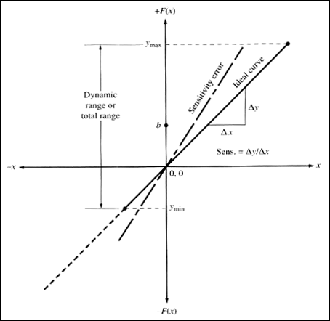
Sensitivity
Sensor sensitivity is defined as the change in output per unit change in input.
The sensitivity of digital sensors is closely related to the resolution.
The sensitivity of an analog sensor is the slope of the output versus input line.
Linear & nonlinear behavior

Slide 11
Error
Error is the difference between a measured value and the true input value.
Two types of errors:
Bias (or systematic) errors and
Precision (or random) errors.
Bias errors can be further subdivided into
Calibration errors (a zero or null point error is a common type of bias error created by a nonzero output value when the input is zero),
Loading errors (adding the sensor to the measured system changes the system),
errors due to sensor sensitivity to variables other than the desired one (e.g., temperature effects on strain gages).

Slide 12
Repeatability & Reproducibility
A measurement system must first be accurate, precise & repeatable before it can be reproducible.
Repeatability refers to a sensor’s ability to give identical outputs for the same input
Precision (or random) errors cause a lack of repeatability

Slide 13
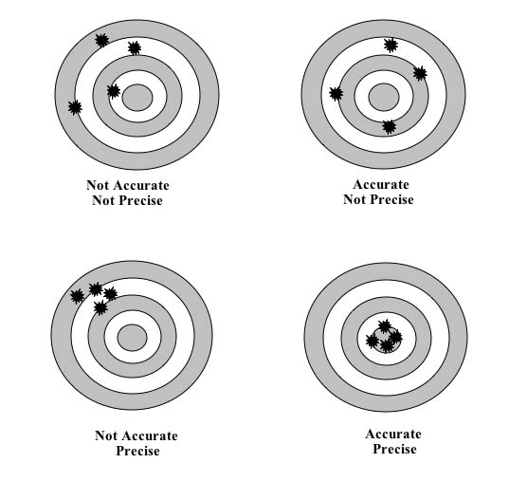
Accuracy, Precision & Repeatability

Slide 14
Saturation, Dead-Band
Saturation: All real actuators have some maximum output capability, regardless of the input.
Deadband: The dead band is typically a region of input close to zero at which the output remains zero. Once the input travels outside the dead band, then the output varies with input.
Desired Output
Saturated Output

Slide 15
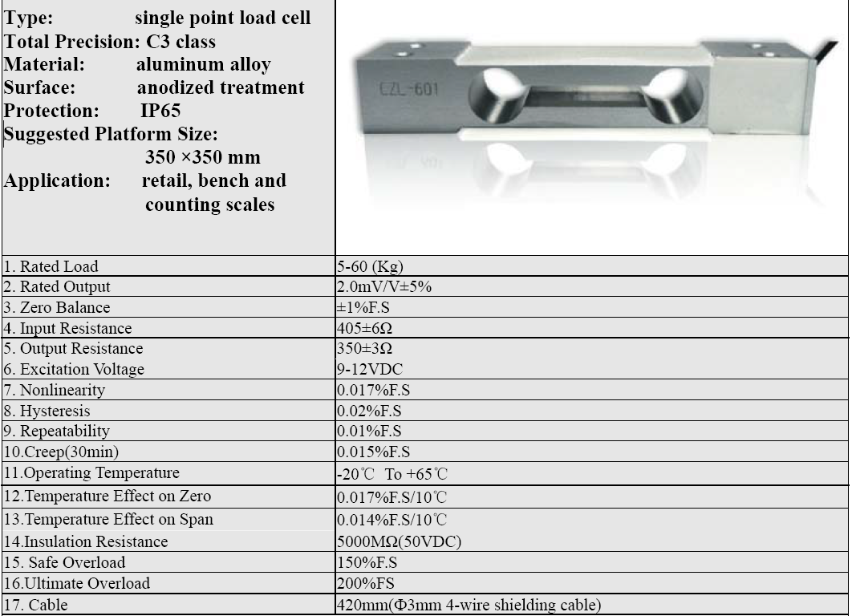

Slide 16
Basic Principle of Sensor / Transduction
Measuring
Parameter
Useful Signal
Conversion Device
Displacement, Temperature, Pressure etc….
Voltage, current, capacitance
Sensor is a device that when exposed to a physical phenomenon (temperature, displacement, force, etc.) produces a proportional output signal (electrical, mechanical, magnetic, etc.).
Transducer is a device that converts one form of (energy) signal into another form of (energy) signal.

Slide 17
Sensors
Position Sensors:
Potentiometer
LVDT
Encoders

Slide 18
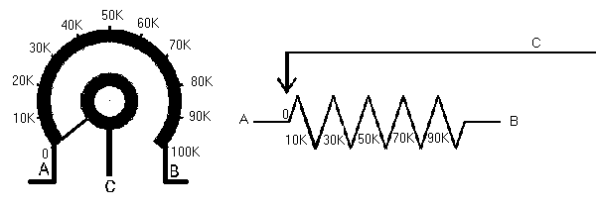
Potentiometer
A rotary potentiometer is a variable resistance device that can be used to measure angular position
Through voltage division the change in resistance can be used to create an output voltage that is directly proportional to the input displacement.

Slide 19
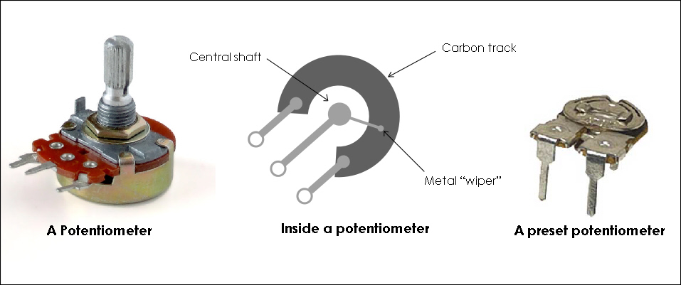
Potentiometer

Slide 20
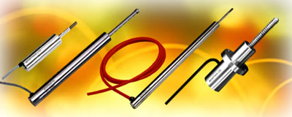
Linear Variable Differential Transformer
‘LVDT’ is a transducer for measuring linear displacement
It must be excited by an AC signal to induce AC response on secondary.
The core position can be determined by measuring secondary response.

Slide 21
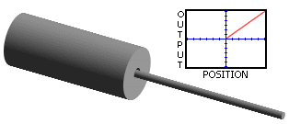
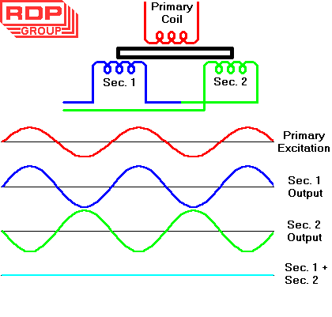
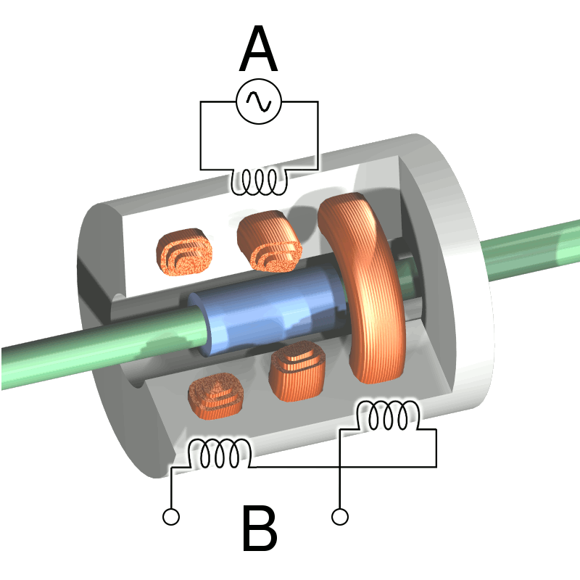
Linear Variable Differential Transformer

Slide 22
Encoders
Digital Optical Encoders
Absolute Digital Optical Encoders
Incremental Digital Optical Encoders

Slide 23
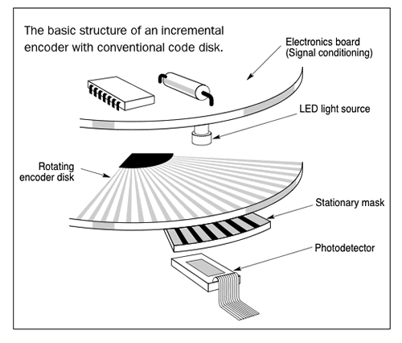
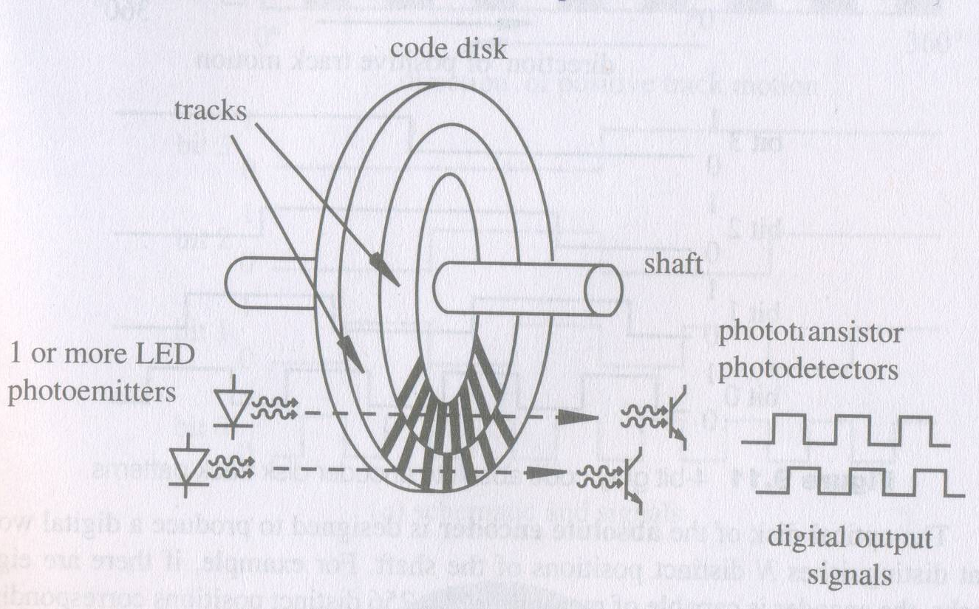
Digital Optical Encoders
Schematic Diagram
Typical Construction

Slide 24
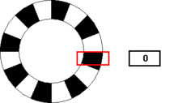
Simple Rotary Encoder

Slide 25
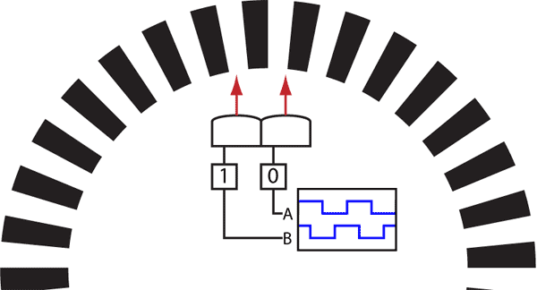
Quadrature Encoder

Slide 26
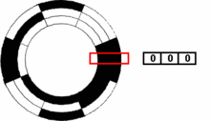
Binary Encoder

Slide 27
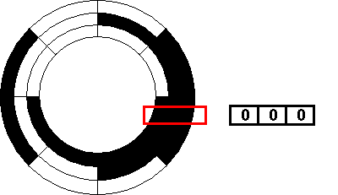
Grey Code Encoder

Slide 28
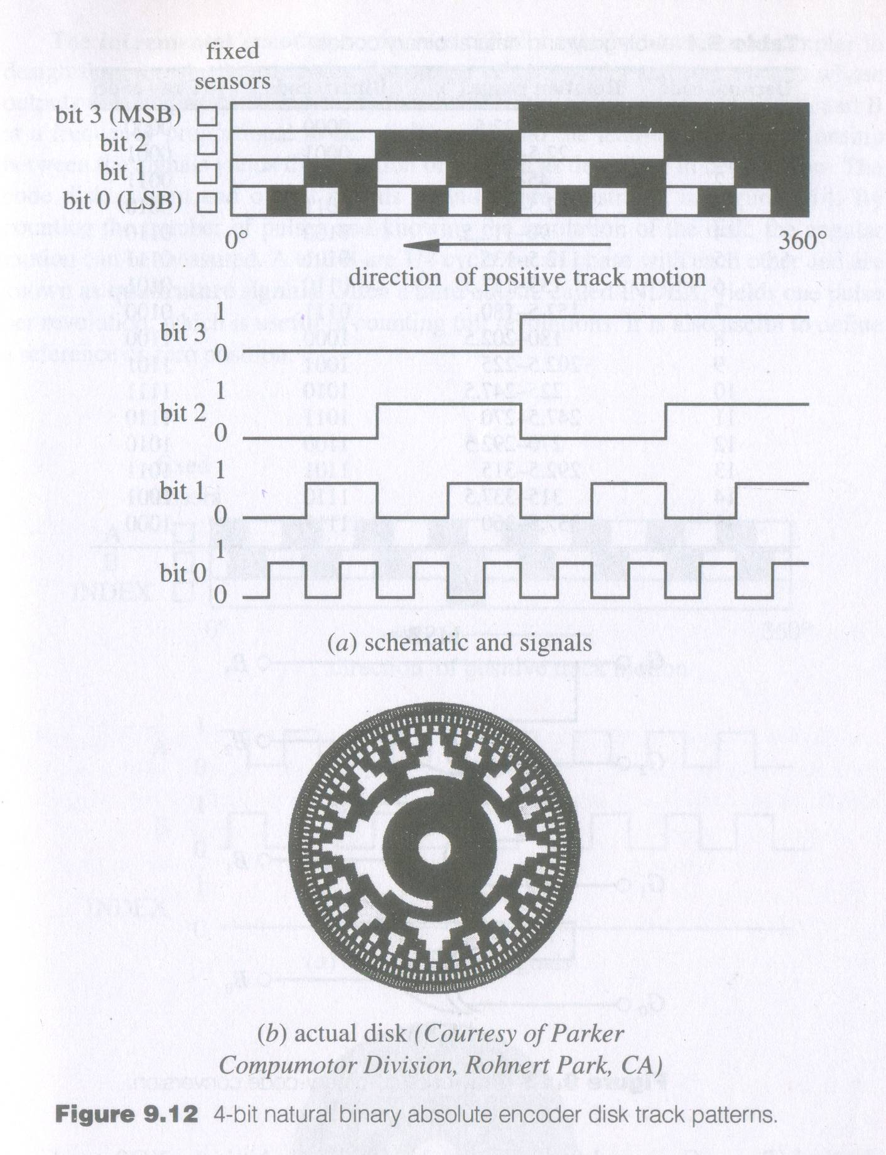
Absolute Encoder

Slide 29
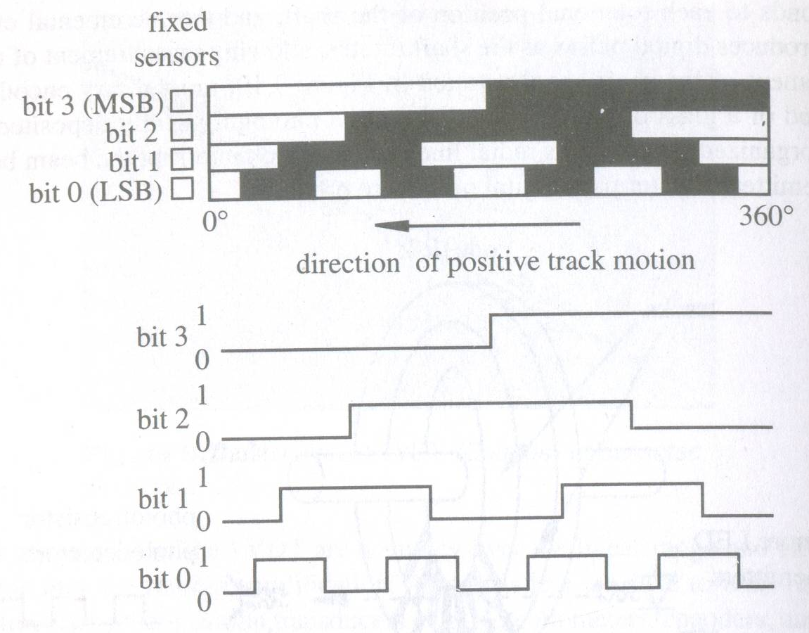
Absolute Encoder (Gray Code)

Slide 30
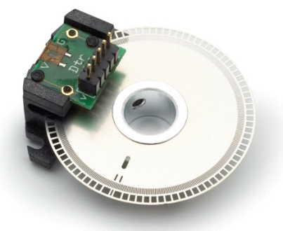
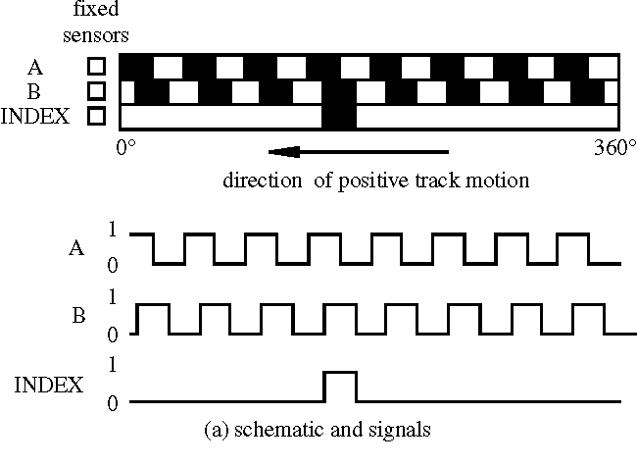
Incremental Encoder

Slide 31
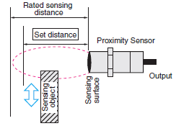
Proximity sensors
Proximity sensors:
Optical
Inductive
Capacitive

Slide 32
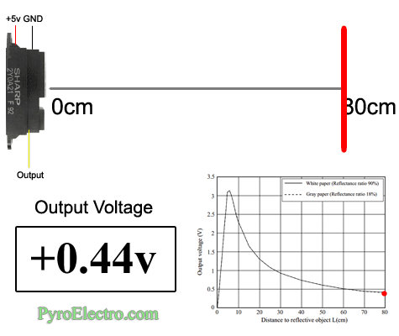
Proximity sensors

Slide 33
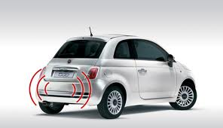
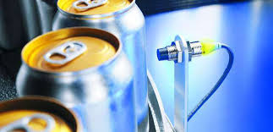
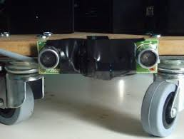
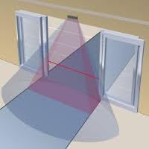
Application of Proximity sensors

Slide 34
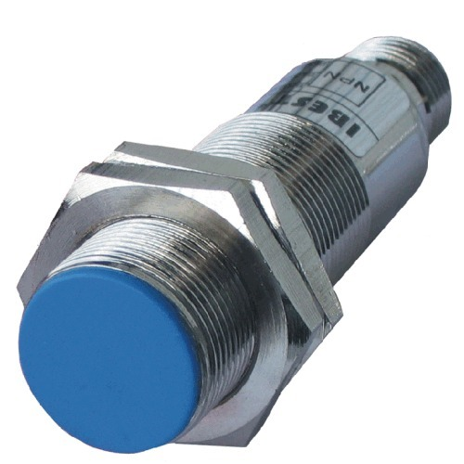
Inductive Proximity sensors
Detects metal object
Uses an electro-magnetic field to detect a conductive target
Sensing coil in the end of the sensor probe
When excited creates an alternating magnetic field which induces small amounts of eddy current in the target object
Eddy currents create an opposing magnetic field which resists the field being generated by the sensor probe coil.
The interaction of the magnetic fields is dependent on the distance between the sensor probe and the target.
Comparatively inexpensive but conducting targets sensing

Slide 35
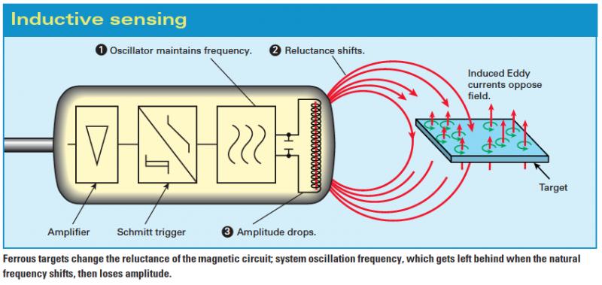
Inductive Proximity sensors

Slide 36
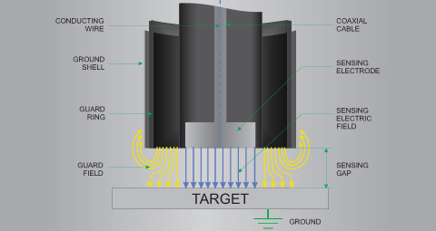
Capacitive Proximity sensors
The sensing surface of the sensor’s probe is the electrified plate.
The sensor electronics continually changes the voltage on the probe surface
The amount of current required change this voltage is measured which indicates the amount of capacitance distance between the probe and target.
Can be used for nonmetallic materials such as paper, glass, liquids, and cloth

Slide 37
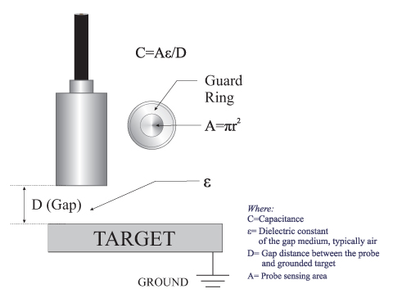
Capacitive Proximity sensors

Slide 38
Motion Sensors:
Variable Reluctance
Temperature Sensor:
RTD
Thermocouples

Slide 39
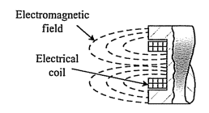
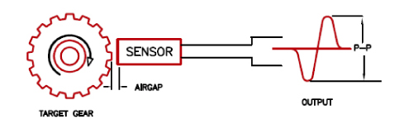
Variable Reluctance sensor
A magnet in the sensor creates a magnetic field
As a ferrous object moves by the sensor, the resulting change in the magnetic flux induces an emf in the pickup coil

Slide 40
Variable Reluctance sensor
Used to measure speed and/or position of a moving metallic object
Sense the change of magnetic reluctance (analogous to electrical resistance) near the sensing element
Require conditioning circuitry to yield a useful signal (e.g. LM1815 from National Semi.)

Slide 41
Temperature measurement
EMF based
Thermocouple
Resistance based
Resistance Temperature Detectors (RTD)

Slide 42
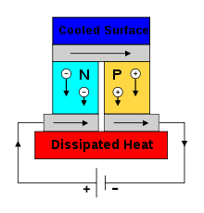
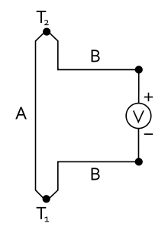
Thermocouples
If two different metals ‘A’ and ‘B’ are connected as in Figure, with a junction and a voltmeter, then if the junction is heated the meter should show a voltage.
This is known as the Seebeck effect.

Slide 43
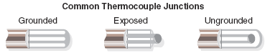
Construction of Thermocouples
At the tip of a grounded junction probe, the thermocouple wires are physically attached to the inside of the probe wall. This results in good heat transfer from the outside, through the probe wall to the thermocouple junction.
In an ungrounded probe, the thermocouple junction is detached from the probe wall. Response time is slower than the grounded style, but the ungrounded offers electrical isolation.
The thermocouple in the exposed junction style protrudes out of the tip of the sheath and is exposed to the surrounding environment. This type offers the best response time, but is limited in use to dry, non-corrosive and non-pressurized applications.

Slide 44
Types of thermocouples
Sr. No | Type | Thermocouple Material | Sensitivity in (µV/ºC) | Useful temperature range
1 | T | Copper-Constantan | 20 – 60 | -180 to +400
2 | J | Iron-Constantan | 45 – 55 | -180 to +850
3 | K | Chromel-Alumel | 40 – 55 | -200 to +1300
4 | E | Chromel-Constantan | 55 – 80 | -180 to +850
5 | S | Platinum-Platinum/10% Rhodium | 5 – 12 | 0 to +1400
6 | R | Platinum-Platinum/13% Rhodium | 5 – 12 | 0 to +1600
7 | B | Platinum/ 30% Rhodium-Platinum/6% Rhodium | 5 – 12 | +100 to +1800
8 | W5 | Tungsten/5% Rhenium-Tungsten/20% Rhenium | 5 – 12 | 0 to +3000
Constantan = copper/nickel; Chromel = nickel/chromium; Alumenl = nickel/aluminium

Slide 45
Selection of Thermocouples
The following criteria are used in selecting a thermocouple:
Temperature range
Chemical resistance of the thermocouple or sheath material
Abrasion and vibration resistance
Installation requirements (may need to be compatible with existing equipment; existing holes may determine probe diameter)

Slide 46
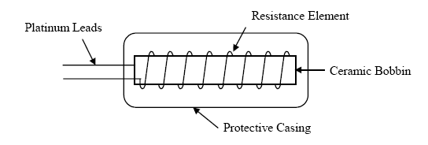
Resistance Temperature Detector (RTD)
Uses the phenomenon that the resistance of a metal changes with temperature.
Are linear over a wide range and most stable.

Slide 47
Advantages of platinum as RTD
The temperature-resistance characteristics of pure platinum are stable over a wide range of temperatures.
It has high resistance to chemical attack and contamination
It forms the most easily reproducible type of temperature transducer with a high degree of accuracy .
It can have accuracy ± 0.01 oC up to 500 oC and ± 0.1 oC up to 1200 oC.

Slide 48
Limitations of RTD
These are resistive devices, and accordingly they function by passing a current through a sensor.
Even though only a very small current is generally employed, it creates a certain amount of heat and thus can throw off the temperature reading.
This self heating in resistive sensors can be significant when dealing with a still fluid (i.e., one that is neither flowing nor agitated), because there is less carry-off of the heat generated.
This problem does not arise with thermocouples, which are essentially zero-current devices.

Slide 49
Comparison: Thermocouple vs RTD

Slide 50
Force/Pressure Sensor
Stress measurement using strain
Strain is change in length (dl) per unit length (l)
Strain gauge is primary sensing element used in pressure, force and position sensors
l
dl

Slide 51
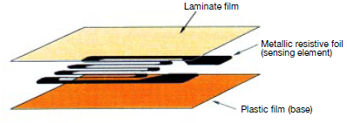
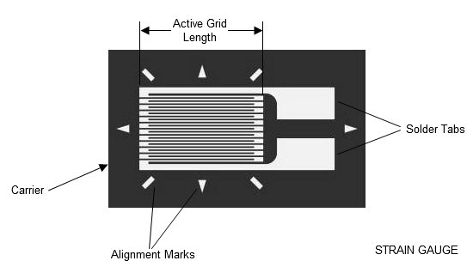
Strain Gauge
Based on the variation of resistance of a conductor or semiconductor when subjected to a mechanical stress.
The electric resistance of a wire having length l, cross section A, and resistivity ρ is:
When the wire is stressed longitudinally, R undergoes a change.
Passing small amount of current through such wire will, thus, help measure voltage change.
The sensing element of the strain gage is made of copper-nickel alloy foil. The alloy foil has a rate of resistance change proportional to strain with a certain constant.

Slide 52
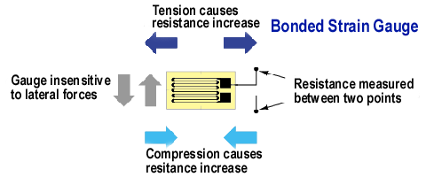
Strain Gauge

Slide 53
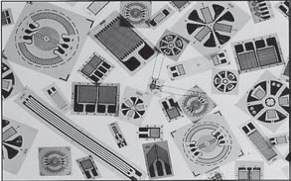
Strain Gauge Type
Types:
Semiconductor Strain Gauge
Thin Film Strain Gauge
Diffused Semiconductor Strain Gauge
Bonded Resistance Gauge
Selection Criterion
Operating Temperature, Nature of Strain, Stability Requirement

Slide 54
Strain Gauge
To measure the strain requires accurate measurement of very small changes in resistance.
For example, suppose a test specimen undergoes a strain of 500 x10⁻⁶.
A strain gauge with a gauge factor of 2 will exhibit a change in electrical resistance of only 2x(500 x 10⁻⁶).
For a 120 Ω gauge, this is a change of only 0.12 Ω.

Slide 55
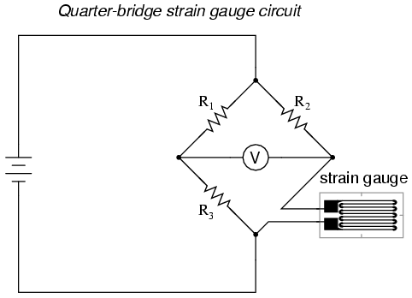
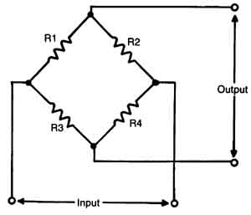
Strain Gauge Circuit
The Wheatstone bridge is an electric circuit for detection of minute resistance changes. It is therefore used to measure resistance changes of a strain gauge.
Strain gauge is connected in place of R4 in the circuit. When the gauge bears strain and initiates a resistance change, ΔR, the bridge outputs a corresponding voltage.

Slide 56
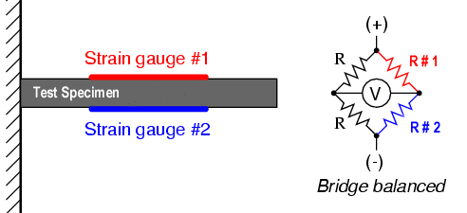
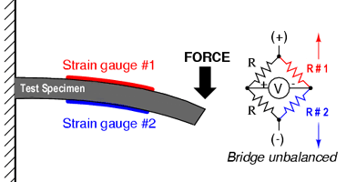
With no force applied to the test specimen, both strain gauges have equal resistance and the bridge circuit is balanced.
However, when a downward force is applied to the free end of the specimen, it will bend downward, stretching gauge #1 and compressing gauge #2

Slide 57
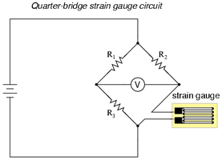
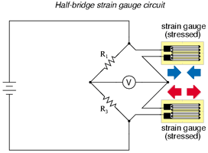
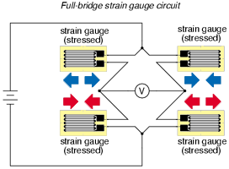
Strain Gauge Circuit

Slide 58
Effect of Temperature on Output of Gauge
Ideally, we would like the resistance of the strain gauge to change only in response to applied strain.
However, strain gauge material, as well as the specimen material to which the gauge is applied, will also respond to changes in temperature.
Strain gauge manufacturers attempt to minimize sensitivity to temperature by processing the gauge material to compensate for the thermal expansion of the specimen material; compensated gauges reduce the thermal sensitivity, they do not totally remove it.

Slide 59
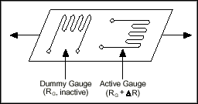
Temperature compensation
By using two gauges
One gauge is active, and a second gauge is placed transverse to the applied strain.
The strain has little effect on the second gauge, called the dummy gauge.
Because the temperature changes are identical in the two gauges, the ratio of their resistance does not change, the voltage does not change, and the effects of the temperature change are minimized.

Slide 60
Electromagnetic Flow sensor
Magnetic flow meters operate based upon Faraday's Law of electromagnetic induction, which states that a voltage will be induced in a conductor moving through a magnetic field.
Faraday's Law: E=kBDV
The magnitude of the induced voltage E is directly proportional to the velocity of the conductor V, conductor width D, and the strength of the magnetic field B.
Magnetic field coils are placed on opposite sides a pipe to generate a magnetic field.

Slide 61
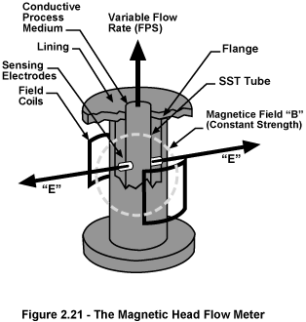
Electromagnetic Flow sensor
As the liquid moves through the field with average velocity V, electrodes sense the induced voltage.
An insulating liner prevents the signal from shorting to the pipe wall.
The output voltage E is directly proportional to liquid velocity, resulting in the linear output of a magnetic flow meter.

Slide 62


Stepper Motor
Discrete Positioning device
Moves one step at a time for each input
Appropriate excitation in winding/s, makes the rotor attract towards the stator

Slide 63


Stepper Motor

Slide 64

Servo Motor
Electric (DC/AC) motor driven using Pulse Width Modulation (PWM)

Slide 65

Servo Motor
Servo mechanism consists of position sensor (potentiometer/encoder), gear mechanism and intelligent circuitry

Slide 66

Solenoid
Electromagnetic actuator
Consist of a movable ferrite core that is activated by current flow
When the coil is energized, a magnetic field is established that provides the force to push or pull the core
Provide large force over a short duration

